Slide 1
Serverless with Azure

Slide 2
Why are all the developers talking
about Serverless?
And who are these people with slides?

Slide 3

About Us
Elizabeth Graham
Global Black Belt Azure Architect
Based in Indianapolis, IN
Been at Microsoft for 4 years
17 years in various roles in Integration
Worked with Azure back in 2010
@esgraham13
Pete Roden
Global Black Belt Azure Architect
Based in Cincinnati, OH
Been at Microsoft for 8 years
Has been in IT stuff for many years
@peteroden
David Barkol
Global Black Belt Azure Architect
Based in Irvine, CA
Been at Microsoft for 2 years
@dbarkol
@azureninjas

Slide 4
The future is Serverless
How do I architect my app to become Serverless?
Notes:
Talking points: (New)
What do we go from here?
Introducing Serverless, an event-driven process, which will grow and scale on demand.
The only remaining question now becomes: How I architect my app to become Serverless? Pretty neat, right?
It all sounds great, naturally, you may ask, how does Serverless fit into the picture?

Slide 5
What is Serverless?
$
Abstraction of servers
Event-driven/ instant scale
Micro-billing
Notes:
Abstraction of servers, infrastructure and configuration of operating system
Event-driven scale
Sub-second billing
Stateless
Serverless compute is a fully managed service. Some refer to it as Functions as a Service
OS and Framework patching is performed for you
There is zero administrative tasks and no need to manage any infrastructure
You just deploy your code (function) and it runs
Your code runs within seconds and for very short period of time
Serverless compute scales quickly (almost instantly) and vastly
Automatically scales within seconds
No scale configuration is required (there is no way to configure scale or limits)
Scales to match any given workload. Scales from zero to handle tens of thousands concurrent functions invocations within seconds
Pay only for the time your code is running
Serverless compute reacts to events
React, in near real-time, to events and triggers
Triggered by virtually any event from Azure service or 3rd party services
Setup time, provisioning is long & costly

Slide 6
Benefits of Serverless
Reduced DevOps
Manage apps not servers
Faster time to market
Notes:
“Pinnacle of PaaS compute”
Not just hardware “servers”, but software servers are also managed for you
Focus on business logic, not solving technical problems not core to business
Lower effort to get started makes it easier to experiment (bots, etc.)
Benefits of “Serverless”

Slide 7
Serverless application platform components
Functions
Execute your code based on events you specify

Slide 8
Serverless application platform components
Logic Apps
Functions
Design workflows and orchestrate processes
Execute your code based on events you specify

Slide 9

Serverless application platform components
Event Grid
Logic Apps
Functions
Manage all events that can trigger code or logic
Design workflows and orchestrate processes
Execute your code based on events you specify

Slide 10

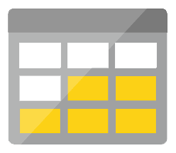

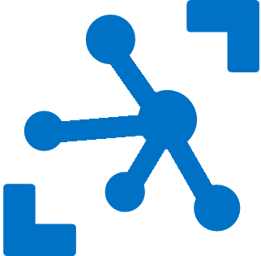


Serverless application platform components
Platform
Event Grid
Logic Apps
Functions
Manage all events that can trigger code or logic
Design workflows and orchestrate processes
Execute your code based on events you specify
Database
Storage
Security
IoT
Analytics
Intelligence

Slide 11

Serverless application platform components
Development
Platform
IDE support
Event Grid
Logic Apps
Functions
Manage all events that can trigger code or logic
Design workflows and orchestrate processes
Execute your code based on events you specify
Integrated DevOps
Local Development
Monitoring
Database
Storage
Security
IoT
Analytics
Intelligence
Visual Debug History

Slide 12
Serverless application platform components
Development
Platform
IDE support
Functions
Logic apps
Event Grid
Integrated DevOps
Developer productivity
Visual designer
Manage all events in one place
Triggers and Bindings
100+ connectors
Near real-time delivery
Local development
Flexible deployment options
Functions orchestration
Broad coverage
Monitoring
Database
Storage
Security & Access Control
IoT
Analytics
Intelligence
Visual Debug History

Slide 13


Introducing Functions
Code
Azure Functions
Events + data

Slide 15
How is serverless development different
Mono-lithic application
Inside client app
Complex framework
Loosely coupled components
Outside client app
Micro-functionality
Notes:
Mono-lithic application -> loosely coupled components
Events happening async outside client application
Build/use micro-functionality to react to a single event

Slide 16
Key Indicators for Serverless

Slide 17
Key Indicators for Serverless
Stateless and scale
Not worth deploying a traditional backend
Workload is sporadic (high volatility of demand)
Dev ops favored versus dedicated ops
Lots of different services that need “glue”

Slide 18
Serverless scenarios: anything that responds to events
Timer-based processing
Real-time stream processing
Every 15 minutes
Find and clean invalid data
Clean table
Millions of devices feed into Stream Analytics
Transform to structured data
Store data in SQL DB
Mobile app backends
Real-time bot messaging
?
...
Photo taken and WebHook called
Stores in blob storage
Produces scaled images
Message sent to Chatbot
Chatbot sends
response
Cortana Analytics answers questions

Slide 19
Hands on Lab: Functions

Slide 20
Patterns to Follow
Keep execution short and return quickly
Decouple tasks
Compile and or pack to optimize cold start times
Notes:
Similar to microservice patterns (12 factor)

Slide 21
Serverless scenarios:
Timer-based processing
Every 15 minutes
Find and clean invalid data
Clean table

Slide 22
Timer Demo

Slide 23
Serverless scenarios:
Real-time stream processing
Millions of devices feed into Stream Analytics
Transform to structured data
Store data in SQL DB

Slide 24
IoT data streaming demo

Slide 25
Serverless scenarios:
Mobile app backends
Photo taken and WebHook called
Stores in blob storage
Produces scaled images

Slide 26
Mobile App Backend Demo

Slide 27
Serverless scenarios:
Real-time bot messaging
?
...
Message sent to Chatbot
Chatbot sends
response
Cortana Analytics answers questions

Slide 28
Bot Services Demo

Slide 29
Pete’s SPA application

Slide 30
New Visual Studio 2017 tooling
Based on class libraries
Get the full power of IntelliSense, unit testing, and local debugging
Use WebJobs attributes to define triggers and bindings
Learn more at https://aka.ms/2017functiontools

Slide 31
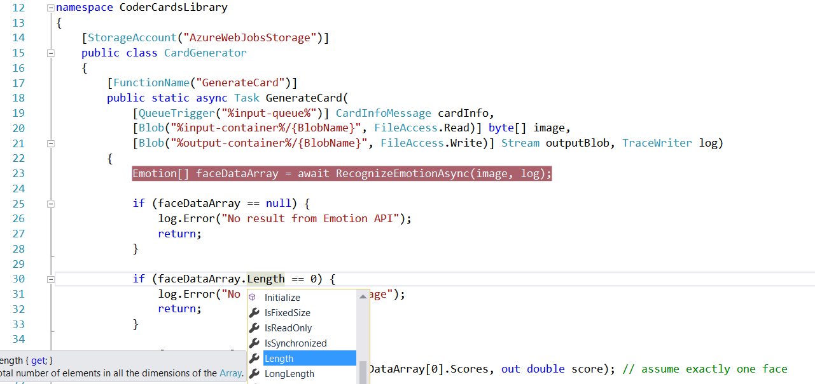
Visual Studio 2017 Tooling

Slide 32
Advanced stuff
Functions CLI and debugging

Slide 33
Platform and scaling
App Service offers dedicated and dynamic tiers.
Dedicated is the existing App Service plan tiers
Basic, Standard, Premium
Pay based on # of reserved VMs
You’re responsible for scale
Dynamic
Pay on number of executions
Platform responsible for scale

Slide 34
Dynamic tier pricing
Pay per execution model - two meters, three units
Number of executions
Duration of execution x reserved memory
First million executions free.

Slide 35

What’s new in Azure Functions
Trigger a function based on changes in Cosmos DB
Database
Local Development
Develop functions locally on Linux, MacOS, Windows
Functions
Durable Functions
Long running, stateful functions
Securely provide access to information in Microsoft Graph through a function
Security
Execute your code based on events you specify
Monitoring
Monitor serverless applications using Application Insights
Trigger a function from a real-time analytics pipeline in Stream Analytics
Analytics

Slide 36
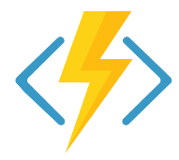
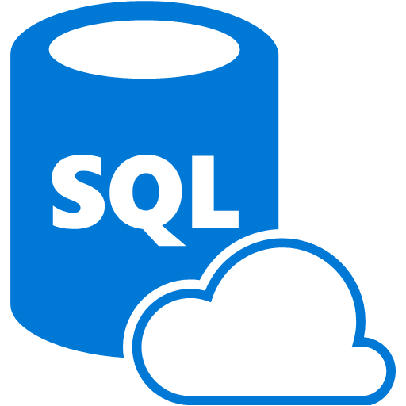

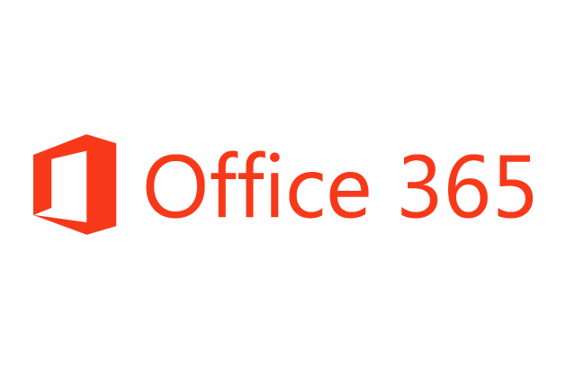
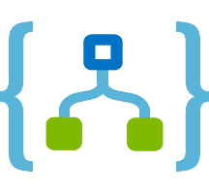
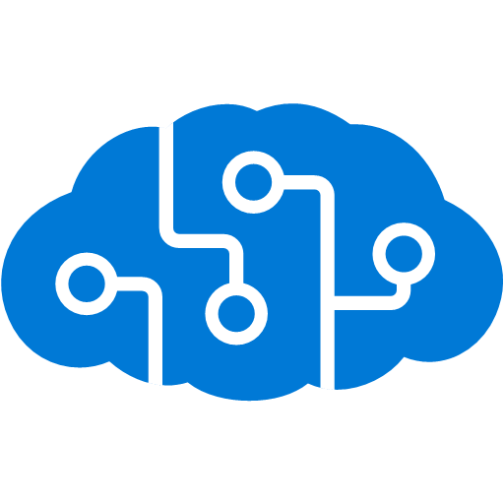
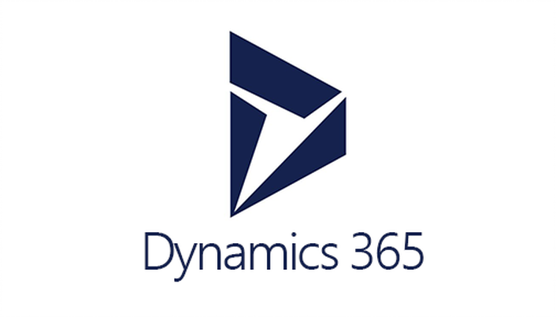


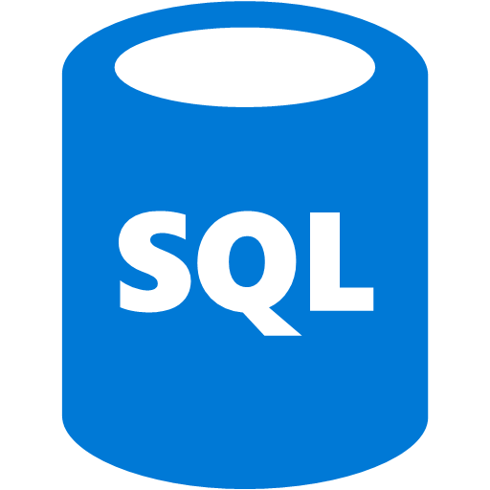
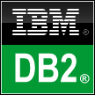



Logic Apps connects everything
Azure Functions
Service bus
Cognitive services
Logic Apps
Machine learning
On-premises data gateway
BizTalk server
Notes:
Logic Apps can integrate with “anything” (APIs) and solve small or complex problems. Automation in a secure and reliable environment fast and easy.
Connect Anything:
On-premises, hybrid and cloud
Mission critical, complex integration scenarios
Business productivity
Agile Business:
Quickly create workflows
Position to the future API centric
Transform Business:
Extract value from both (on-premises and cloud apps)
Build Holistic integration solutions.

Slide 37
Everything? Really?
Okay, not everything. But there are 200 connectors and in
preview is the ability to create custom connectors. And with
Event Grid, we have many more options as well.

Slide 38

SaaS
10to8
Act!
Adobe Creative Cloud
appFigures
Asana
Azure Active Directory
Azure API Management
Azure App Services
Azure Application Insights
Azure Automation
Azure Cognitive Face API
Azure Cognitive LUIS
Azure Cognitive Text Analytics
Azure Cognitive Vision
Azure Data Lake Store
Azure Document DB
Azure Event Hubs
Azure Event Grid
Azure Files
Azure Functions
Azure Machine Learning
Azure Resource Manager
Azure Service Bus
Azure SQL
Azure Storage Blob
Azure Storage Queues
Basecamp2&3
Benchmark Email
Bing Maps
Bing Search
BitBucket
Bitly
Blogger
XML
XML Validation
Transform XML (+Mapper)
Flat File Encode
Flat File Decode
Int Account Artifact Lookup
EDI
X12
EDIFACT
AS2
Protocol/
Native
Batching
HTTP, HTTPS
HTTP Webhook
FTP, SFTP
SMTP
RSS
Compose, Parse JSON
Query, Join, Table, Select
Schedule, Wait
Terminate
Workflow
Hybrid
BizTalk Server
File System
IBM DB2
Informix
Oracle DB
MySQL
PostgreSQL
SharePoint Server
SQL Server
SAP
Teradata
Websphere MQ
Box
Buffer
Calendly
Campfire
CapsuleCRM
Chatter
Cognito Forms
Common Data Service
Disqus
DocuSign
Dropbox
Dynamics CRM Online
Dynamics CRM Service Bus
Dynamics for Financials
Dynamics for Operations
Dynamics NAV
Easy Redmine
Elastic Forms
Eventbrite
Facebook
FreshBooks
Freshdesk
FreshService
GitHub
Gmail
Google Calendar
Google Contacts
Google Drive
Google Sheets
Google Tasks
GoTo Meeting
GoTo Training
GoTo Webinar
Harvest
HelloSign
HipChat
Infusionsoft
Inoreader
Insightly
Instagram
Instapaper
Intercom
JIRA
JotForm
LeanKit
LiveChat
MailChimp
Mandrill
Microsoft Forms
Microsoft Teams
Microsoft Translator
Medium
MSN Weather
Muhimbi PDF
Nexmo
Office 365
Office 365 Users
Office 365 Video
OneDrive
OneDrive for Business
OneNote
Outlook.com
Outlook Customer Manager
Outlook Tasks
Paylocity
PagerDuty
Parserr
Pinterest
Pipedrive
Pivotal Tracker
Planner
Power BI
Project Online
Redmine
Salesforce
Salesforce Chatter
SendGrid
SharePoint Online
Slack
SmartSheet
SparkPost
Stripe
Survey Monkey
Teamwork
Teradata
Todoist
Toodledo
Trello
Twilio
Twitter
Typeform
UserVoice
Vimeo
VS Team Services
Webmerge
Wordpress
Wunderlist
Yammer
YouTube
Zendesk
Cloud APIs and platform functionality
To your services, apps, LOB systems
Hosted and managed within the platform
Scales to meet your needs
First class designer experience
Rapid development
Over 160 built-in connectors
Don’t see what you need?
aka.ms/logicapps-wish
API connections
Authenticate once and reuse
Differentiate connection configuration
Simple to deploy
Portal experience for managing API Connections

Slide 39
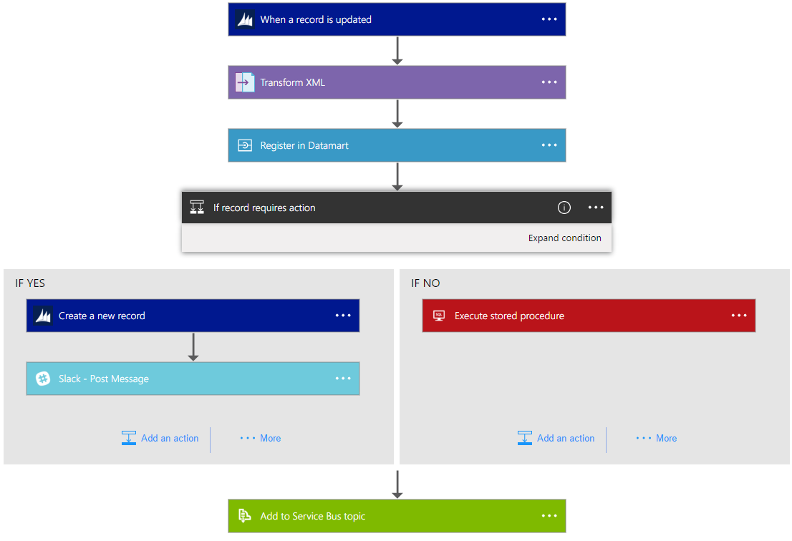
Logic Apps Workflow Designer
Workflow in the cloud
Powerful control flow
Connect disparate applications
No code designer for rapid creation
Also works within Visual Studio for added CI/CD

Slide 40
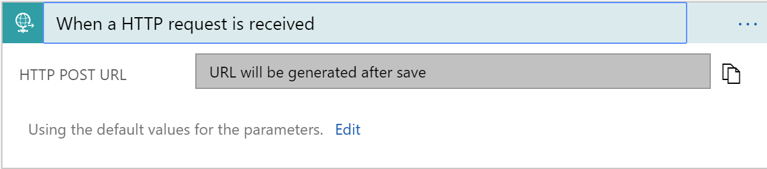
Triggers
All logic apps start with a trigger, typically a connector
Recurring and Adv. Scheduling
Polling
Webhook
Request

Slide 41
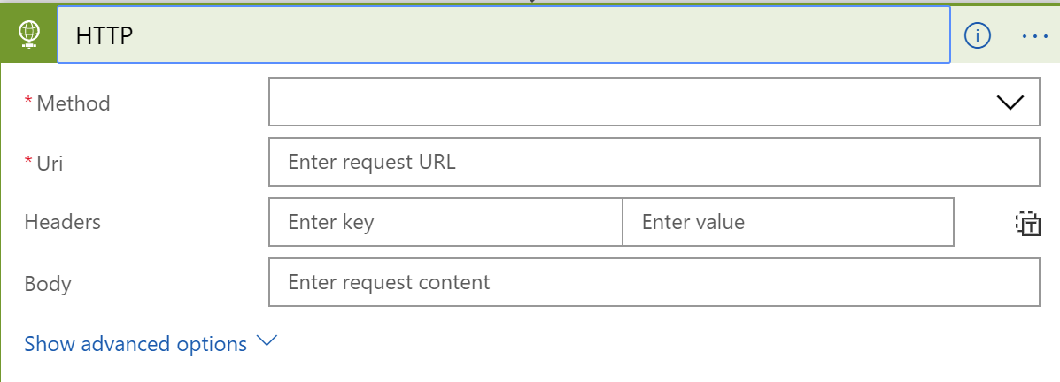
Actions
All logic apps continue with actions, which is also most of the time, a connector
Invoke APIs and Services
Behaviors
Variables
Expressions and Operators

Slide 42
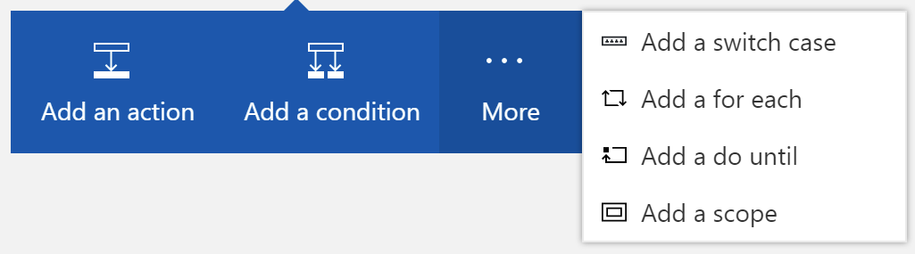
Workflow Features
To control your logic app's workflow, you can specify different paths for your logic app to run and how to process data in arrays, collections, and batches

Slide 43
Logic Apps Demo
Notes:
TIME MARKER: 10:40 A.M.

Slide 44
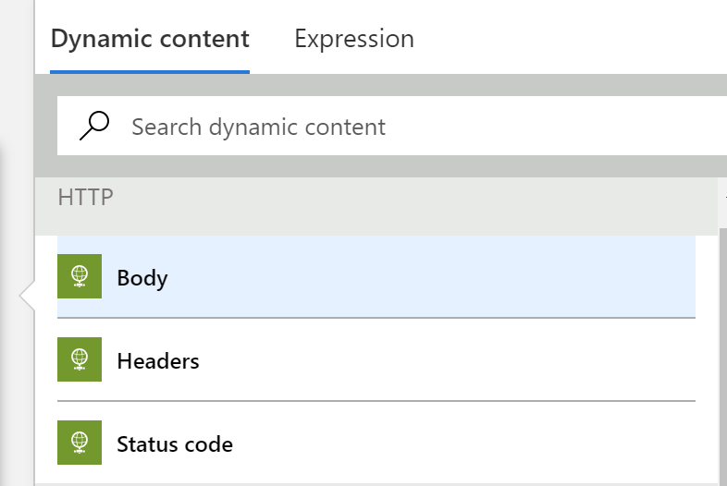
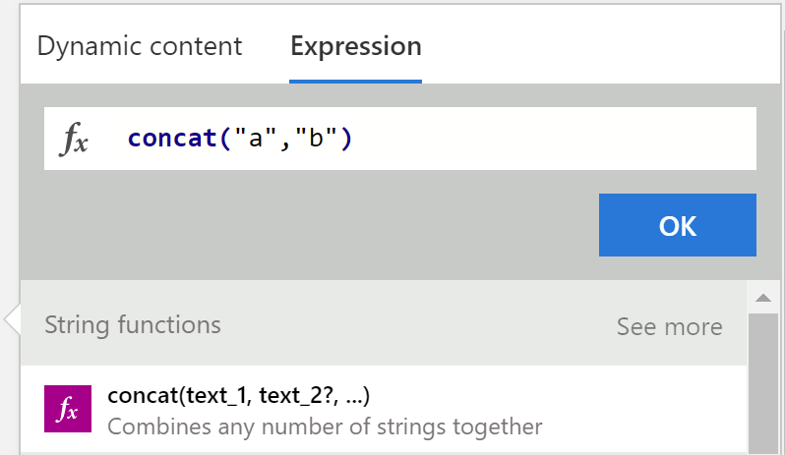
Tips and Tricks
Dynamic Content
Expressions

Slide 45
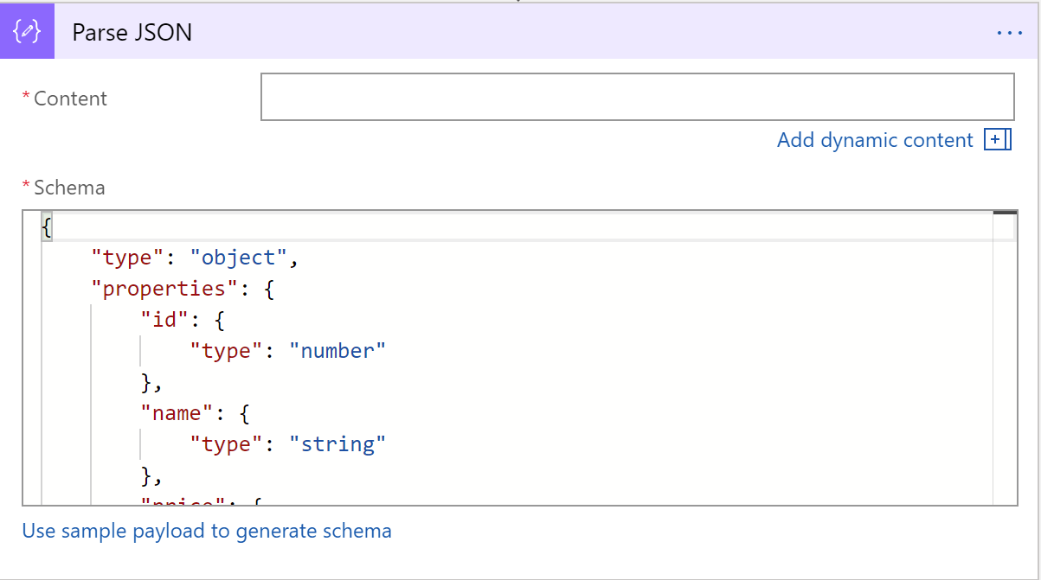
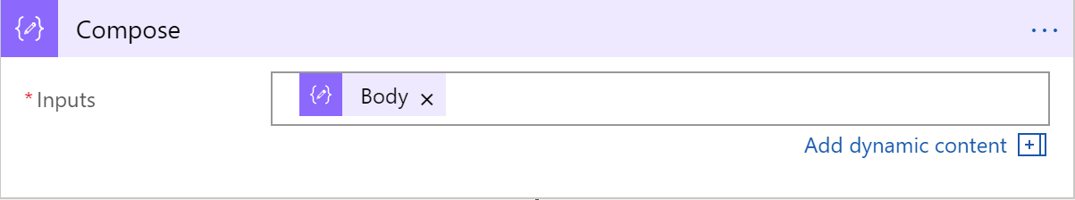
Tips and Tricks
Common shapes that will be used
Parse JSON
Compose
Notes:
Parse JSON – take a JSON object and convert to a specified schema
- constructing any output, including objects, arrays, and any other type natively supported by logic apps

Slide 46
Workflow Patterns

Slide 47
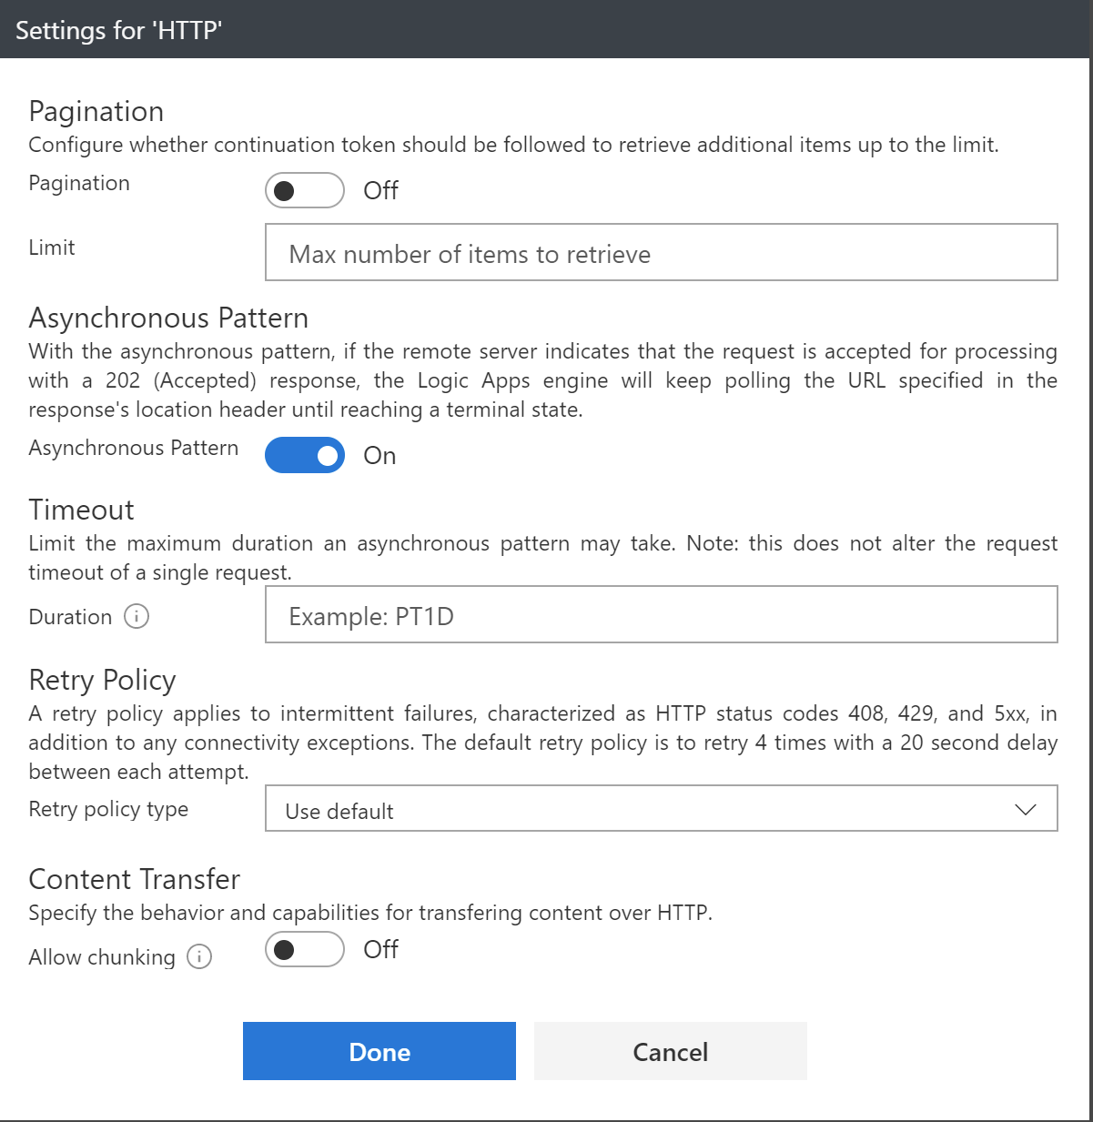
Error Handling
Notes:
Retry policy
Default, custom, and disabled
Run After
Conditional dependency control
Status: Succeeded, Failed, TimedOut, Skipped
Terminate
Early termination
Failed or Successful status
Scopes
Encapsulate a set of actions
Status: Determined by the status of the leaf nodes within the Scope
Succeeded: all must have succeeded
Skipped: all must have been skipped
Failed: any not succeeded or skipped

Slide 48
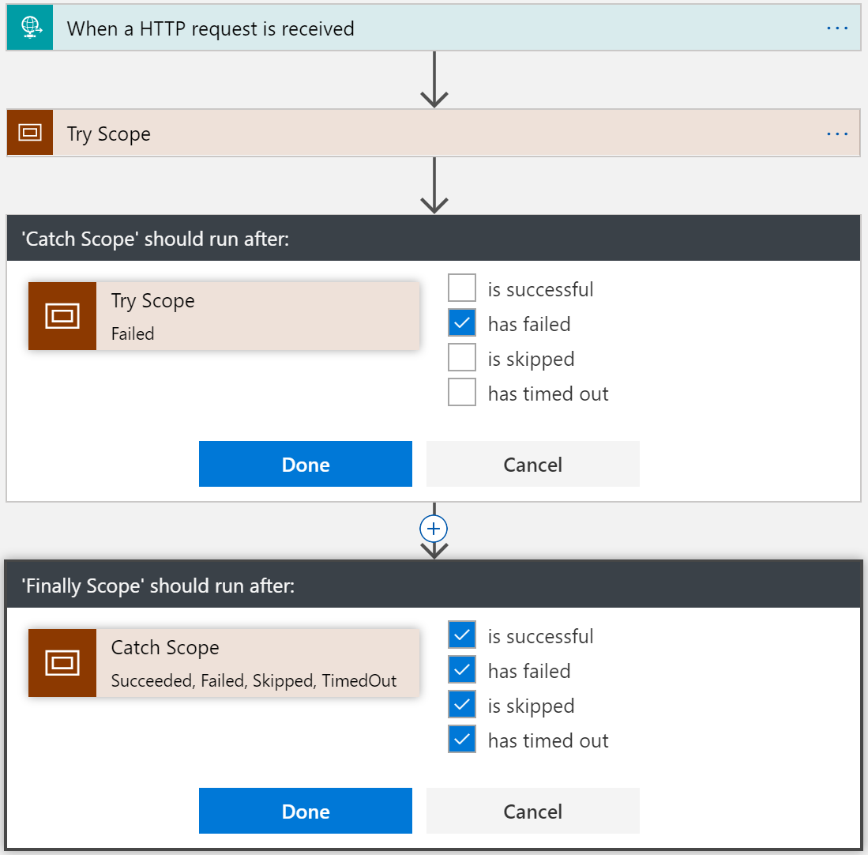
Try-Catch-Finally Pattern
Try
Put actions in a Try scope
Catch
Run after Try scope Failed
Finally
Run after Catch scope Succeeded, Skipped, TimedOut, or Failed
Notes:
Scopes
Encapsulate a set of actions
Status: Determined by the status of the leaf nodes within the Scope
Succeeded: all must have succeeded
Skipped: all must have been skipped
Failed: any not succeeded or skipped

Slide 49
Long Running Processing
Until Condition is met
Do-until loop
Evaluated condition, total time, or count
When a Timeout has occurred
Configure timeout action setting
While other work is being done
Parallel actions

Slide 50
Concurrency Control
Runs
Instances are created concurrently
Singleton trigger executions
Degrees of parallel execution
Only for non split-on polling triggers
For Each Loops
Collections handled concurrently
Sequential For Each
For each degrees of parallelism
Parallel actions
Explicit parallelization
Join with Run After
Do Until Loops
Runs sequentially

Slide 51
Scheduling executions
Example workloads
Cleanup jobs, data synchronization, running reports, data compression
Simple Recurrence
Every 5 minutes, every 2 days
Recurrence with deterministic time
Use start time
Every hour on the hour, every day at midnight
Complex schedules
Every Sunday at noon, every 15 minutes during work hours
Run once jobs
Show pattern (next slide)

Slide 52
Advanced scheduling
// Occur on the last Friday of every month at 8:30am and 5:30pm
"triggers": {
"Recurrence":
"recurrence":
{
“startTime": "2017-11-01T15:30:30Z",
"frequency": "month",
"interval": 1,
"schedule":
{
"minutes": [30],
"hours": [8,17],
"monthlyOccurrences":
[
{"day": "friday", "occurrence": -1}
]
}
},
"type": "Recurrence"
}

Slide 53
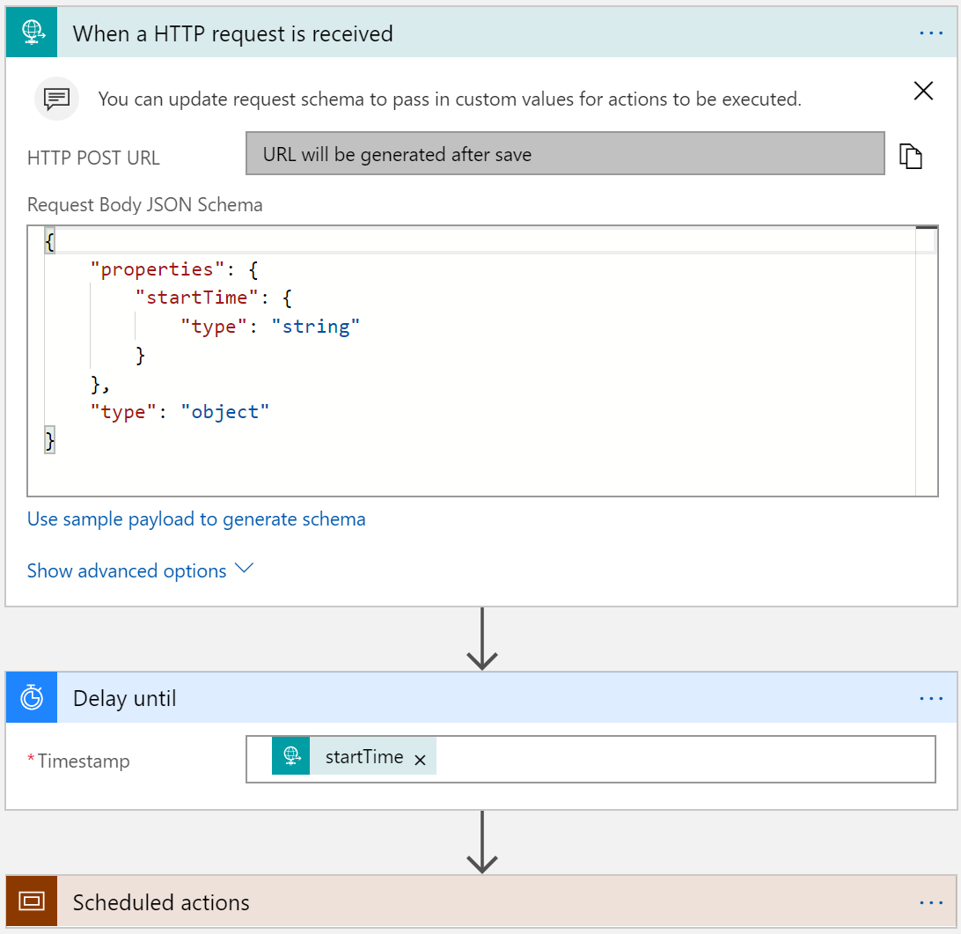
Run Once Jobs
Request trigger
Start time input
Delay Until (start time)
Instantiate millions of scheduled jobs

Slide 54

Batching
Grouping and processing messages
2 Logic Apps – sender and receiver
‘batcher’ aware of batching logic app
Batching logic app not aware of batcher(s) – 1:n
Partition within batch
Config
Event
Time based
Count Based
Size based (soon)
Batch
Trigger

Slide 55
Hands on Lab: Logic Apps

Slide 56
Learnings
Know the Limits of Logic Apps
Consider the workflow – high throughput vs long running workflow
Understand the data structure
Leverage concurrency as much as possible
Consider side-by-side strategy for testing
Logic Apps are ran either at least once or at most once, not only once.

Slide 57
Misconceptions and Gotchas
Not a lightweight BizTalk
Its not a silver bullet
Be aware of the workload (for loops, etc)
Management is either in the portal or Visual Studio
ALM is defined in VSTS, but has short comings
There is not much guidance – but that’s why were here!

Slide 58


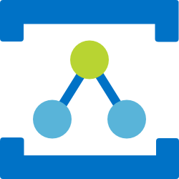

Azure Messaging Services
Service Bus
Event Hubs
Relay
Event Grid
Asynchronous enterprise messaging
Distributed data streaming
Secure two way communication without changes to your network
Cross cloud reactive eventing
Notes:
When we look at what we have in Azure today for messaging services, we have many options. Some of them include:
Service Bus – a messaging platform for the enterprise, similar to MSMQ or Tibco for those who are familiar with those offerings.
Event Hubs – a distributed data streaming platform. Very similar to Kafka
Relay – a service that facilitates hybrid applications by securing two-way communication within a corporate network and Azure. This is actually one of the oldest services in Azure.
Event Grid - a messaging platform that is intended to bring events to the cloud, just like what we are accustomed to with operating systems and user interfaces.
A common question is “why do we have all these different services?”. The answer is that each one is designed to support a specific type of messaging task. This is by design instead of trying to make one service do many things, which in some cases might end up being unnatural.

Slide 59

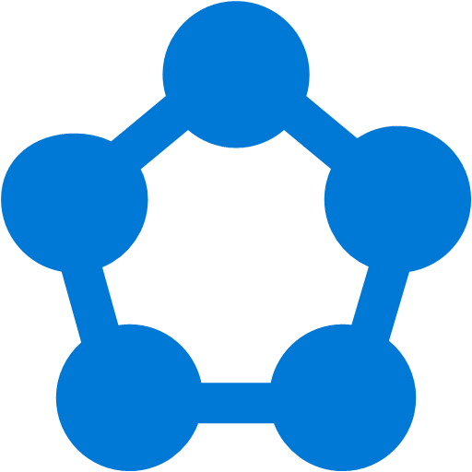
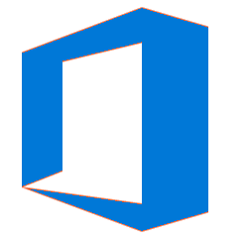







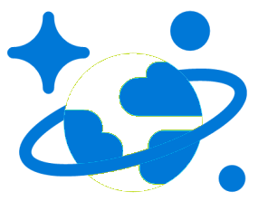
Modern computing is all about events
Notes:
Modern computing today is distributed, more than ever. As a result, all these services can be viewed as islands.

Slide 60
?
Managing events is important but cumbersome
?
?
?
?
?
?
?
?
?
?
?
Notes:
Because they are disconnected, we are responsible for tying them together and this can end up being cumbersome. In fact, a great deal of time is often invested in managing the events that need to make these services work together and it can be quite taxing for the development process.

Slide 61

What if all these events could be managed and directed from one place?
Notes:
One of the principal tenants of Event Grid is to bring all these events together in one place. Instead of using webhooks to tie everything together, we can use a centralized service instead.

Slide 62
Azure Event Grid
Fully-managed event routing
Near real-time event delivery at scale
Broad coverage within Azure and beyond
Backbone of event-driven computing
Notes:
If you’ve done any UI work in the past, you might be familiar with delegates and event-driven programming. This has been a solved problem for a long time within application, now it is finally coming to the cloud.

Slide 63
Benefits
Focus on innovation and pay per event
Ensure reliability and performance for your apps
Unlock new scenarios for your apps
Manage all events in one place

Slide 64
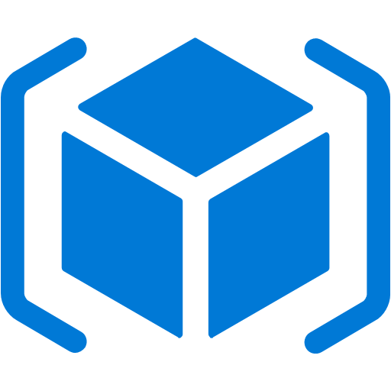

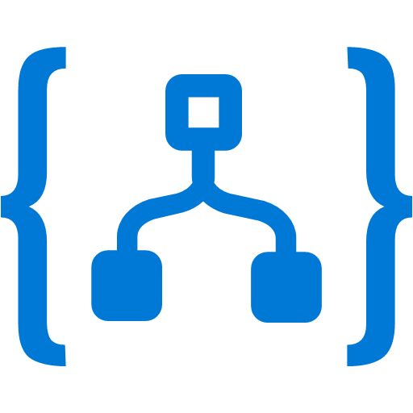
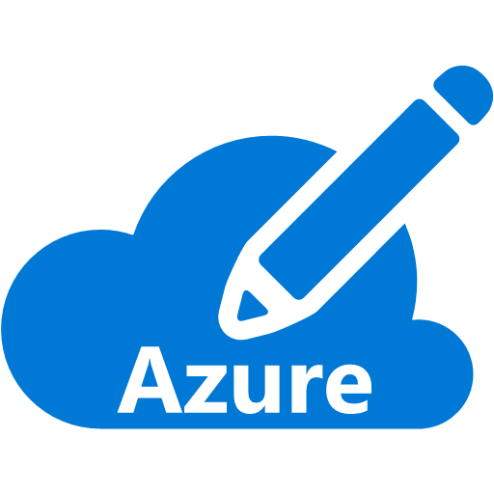

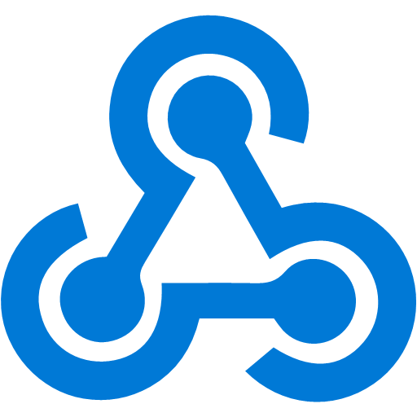

Manage all events in one place
Event publishers
Event handlers
Blob Storage
Azure Functions
Resource Groups
Logic Apps
Azure Subscriptions
Azure Automation
Event Hubs
WebHooks
Custom Events
Notes:
It comes down to having a collection of event publishers and event handlers.

Slide 65
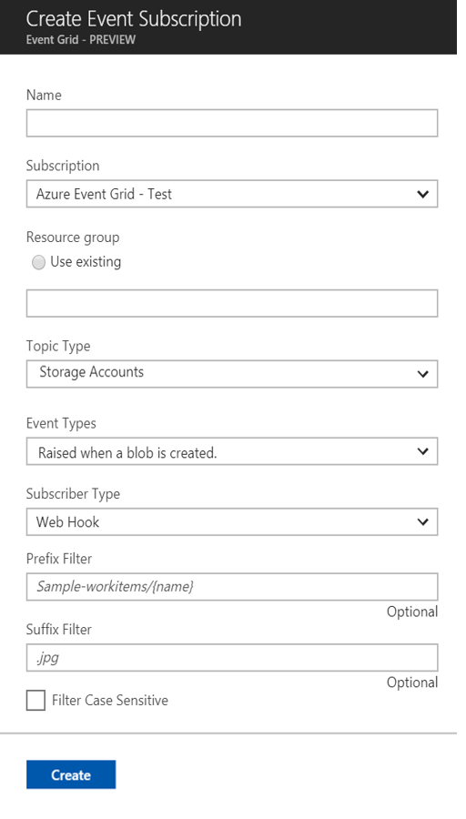
Manage all events in one place
Event publishers
Event handlers
Subscribe to pre-defined system events in Azure or create your own custom topics
Route events to any end-points, Azure or even beyond
Enable filtering and efficient routing of events
Notes:
This is a simplified view of what managing events looks like.

Slide 66
Ensure reliability and performance in your apps
Sub-second end-to-end latency in the 99th percentile
10,000,000 events per second per region
24-hour retry with exponential back off for events not delivered
Near real-time
Massive scale-out
High reliability
Notes:
We want to deliver reliable notification in near real-time, at massive scale. It needs to be highly reliable, you should be able to create items/messages that you can’t afford to lose.

Slide 67
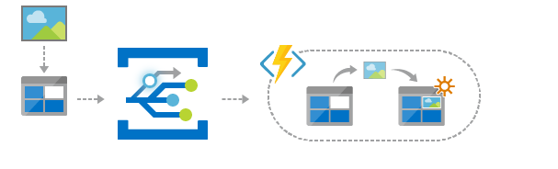
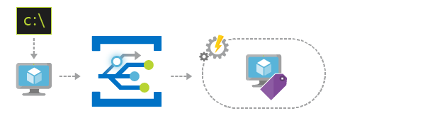
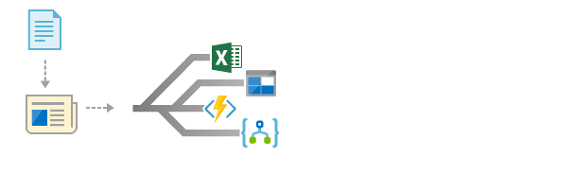
Scenarios
Serverless apps
Ops automation
Application integration
Instantly trigger a serverless function to run analysis when a new file is added to a blob storage container.
Speed up automation and simplify policy enforcement by notifying Azure Automation when underlying infrastructure is provisioned
Connects your app with other services. Create an application topic to route your app’s event data to any desired destination
Notes:
Serverless apps turns out to be one of the areas with the most impact. Event Grid can trigger many of these scenarios.
Ops automation – most people use Lambda for this and we anticipate this being used in concert with ARM.
Application integration – probably the most obvious one, integration between applications and organizations.

Slide 68
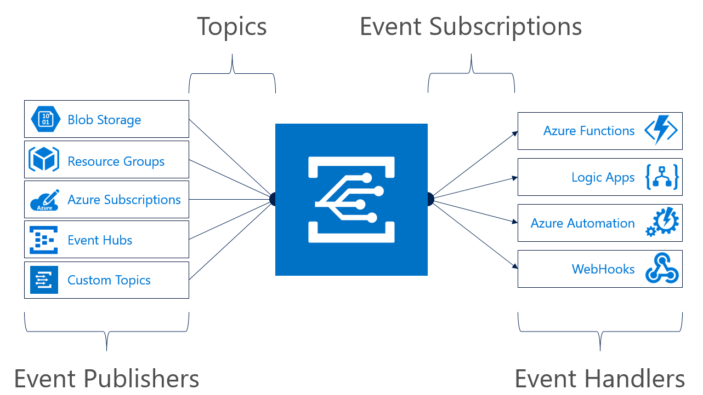
Concepts
Events: what happened
Event Publishers: where it took place
Topics: where publishers send events
Event Subscriptions: how you receive events
Event Handlers: the app or service reacting to the event
Notes:
Most topics in Event Grid are implicit unless you are using custom topics.

Slide 69
Event Grid guiding principles
Events are independent
Always available
Near real-time event delivery
At least once delivery
Dynamic scale
Platform agnostic (WebHook)
Language agnostic (HTTP protocol)

Slide 70
Target performance
Sub-second end-to-end latency in the 99th percentile
99.99% availability
10,000,000 events per second per region
100,000,000 subscriptions per region
50 ms publisher latency
24 hour retry with exponential back off for events not delivered
Transparent regional failover
Notes:
24 hour retry is the GA target, today it is just for 2 hours.

Slide 71
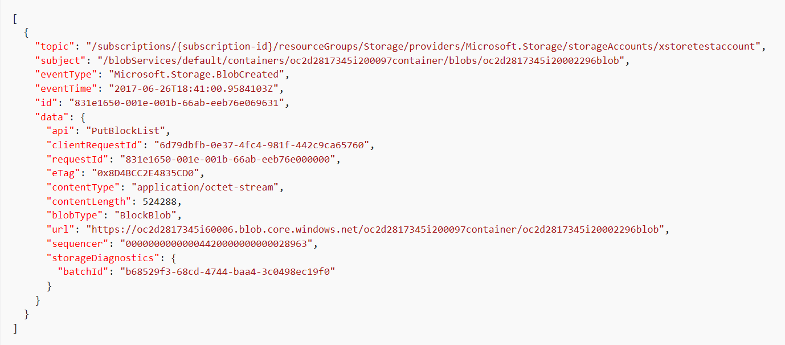
Event Schema
Notes:
This is an example of a storage event.
The data property contains contextual information about the payload from the publisher.

Slide 72
Resource model: extension resource
ARM calls are made to a parent resource
ARM reroutes all Event Grid calls to the Event Grid RP
Notes:
When you are interacting with Event Grid, you are actually communicating with an extension of the resource provider for that service.

Slide 73
Demo

Slide 74

Azure Resource Manager & Logic Apps

Slide 75
Why does this all matter anyway?
Loosely coupled
Using the right tool for the right task
Knowing the difference between Events and Telemetry / streams

Slide 76
Learn more at azure.com/EventGrid

Slide 77


Integration
Example: Invoice Processing
API Management
Logic App
Function
Post new invoice
Convert to JSON
Grab raw file
Store record
API layer
Fetch Invoice
Notes:
Chris

Slide 78
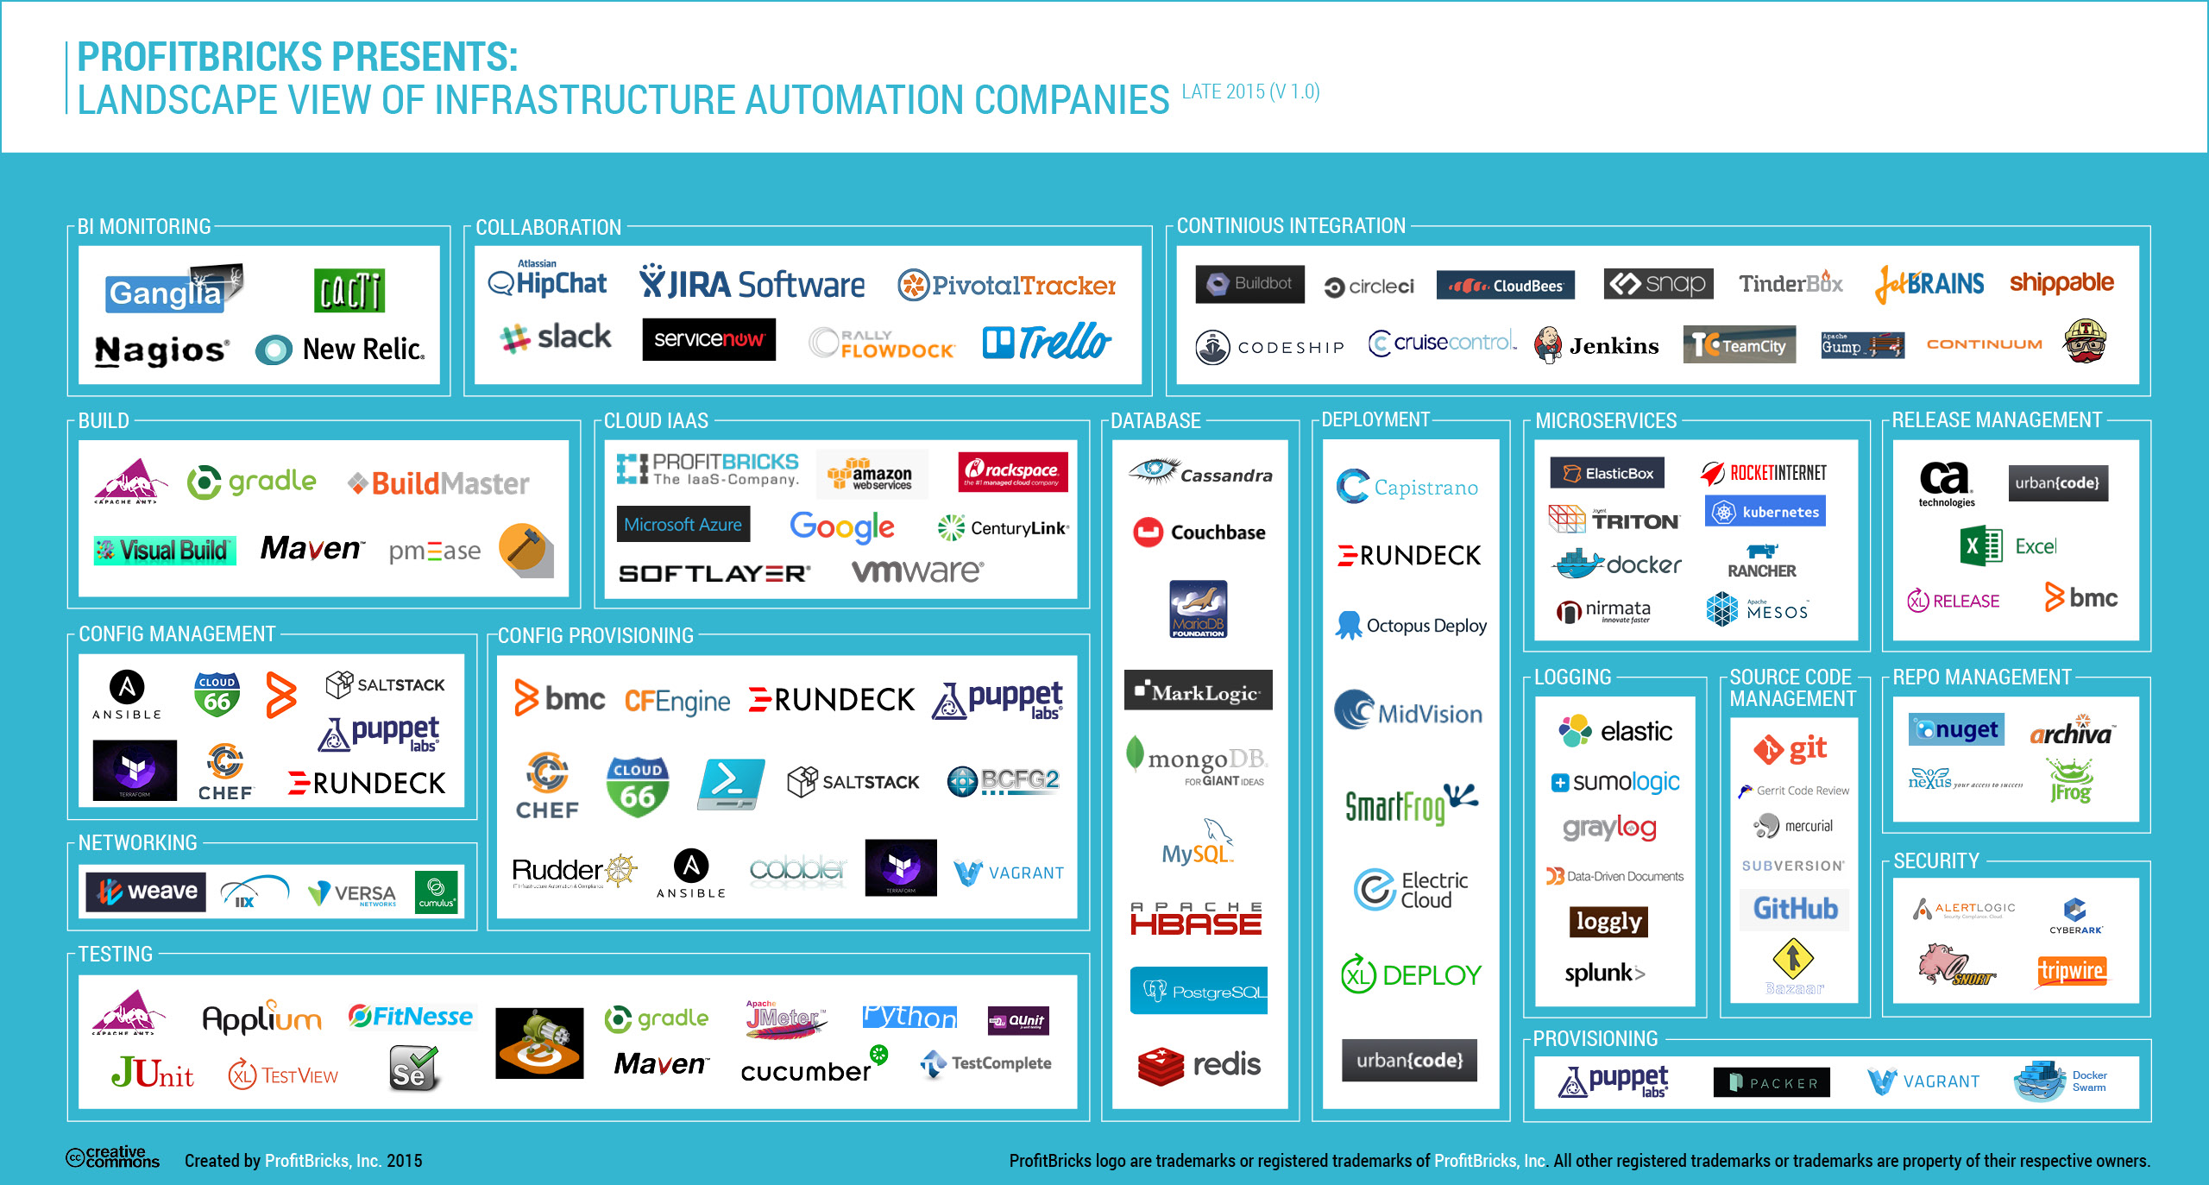
Microservice tools and approaches
Microservices in the wild
Azure Functions
Azure Service Fabric
Implication: Build your own microservices platform
Benefits: Customizable, pick best of breed solutions
Implication: Serverless microservices
Benefits: Quick ramp up, sub second metering, zero ops
Implication: Prescriptive microservices platform
Benefits: Easy to build, deploy and manage microservices at scale
Event-driven scale
No Ops

Slide 79
Summary: build apps faster
Functions
Logic Apps
Consumption and provisioned options
Local development and advanced DevOps with detailed monitoring
Bindings to first and third-party services
Open source runtime
Rich portal visual designer and Visual Studio integration
Switch statements and loops
120+ connectors to SaaS and PaaS, with custom connector support
ARM template-based for easy reuse

Slide 80
Questions?

